Slide 1
20 years of sequencing ?-omes
Greg Gloor
Department of Biochemistry
University of Western Ontario
ggloor@uwo.ca @gbgloor

Slide 2
A brief timeline of seq-omics and microbiome
My PhD

Slide 3
My sequencing journey
Manual
Capillary
454
Ion Torrent
HiSeq
ABI SoLID
Solexa/Illumina GA
MiSeq
NextSeq
minION
NovaSeq

Slide 4
It’s all just sequencing!
ChIP seq
Collect DNA
RNA seq
Standardization?
Normalization?
0 values?
DeSeq
edgeR
voom
limma
…
whatever seq

Slide 5
It’s all just sequencing!
ChIP seq
Collect DNA
16S seq
RNA seq
Standardization?
Normalization?
0 values?
DeSeq
edgeR
voom
limma
…
whatever seq

Slide 6
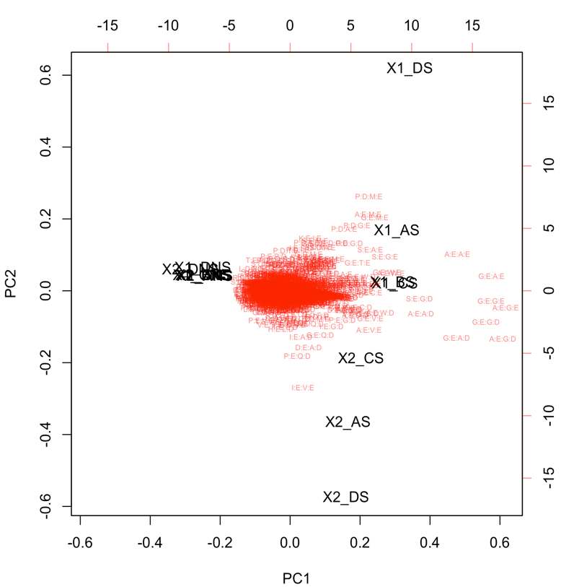
It’s all just sequencing!
Explore
Probabilistic random sample
Ratios not numbers
ALDEx2
CoDaSeq
omicPlotR
Collect DNA
whatever seq
Differential
Fernandes et al. 2014. Unifying the analysis of high-throughput sequencing datasets: characterizing {RNA}-seq, 16{S} r{RNA} gene sequencing and selective growth experiments by compositional data analysis. Microbiome
Gloor et al. 2017. Microbiome Datasets Are Compositional: And This Is Not Optional. Frontiers in Microbiology
Functionalize

Slide 7
Three quick stories
Low complexity sequencing on the Illumina platform
The importance of understanding the platform
Error rates
Microbiomes in the Chinese population
Reproducibility and stability
Hybrid short-long read analysis of microbiomes
Ecosystem function

Slide 9
Sequencing error in the primers
3-4.5 logs
Sources of variation
Mis-synthesis
PCR error (linear)
Library prep error
Sequencing error

Slide 10
OTU error
2.5-
4.5 logs
About 3-5X greater error rate
All of the previous but primer synthesis
PCR error (exponential)
Natural variation
Notes:
Microbiome accepts variant with minimum 2 observations
Genomics requires coverage of > 30
I’ll leave it to you to figure out if the ‘rare biosphere’ can be discovered by 16S rRNA gene sequencing

Slide 11
OTU error
2.5-
4.5 logs
This is what the DaDa2/ASV approach is attempting to model
About 3-5X greater error rate. Attributable to
All of the previous but primer synthesis
PCR error
Natural variation

Slide 13
Stable to sub/supersetting

Slide 14
Internally consistent results

Slide 15
Functionalizing meta-seq ‘omes
A sequence is a sequence is a sequence
Macklaim & Gloor 2018. From RNA-seq to Biological Inference: Using Compositional Data Analysis in Meta-Transcriptomics. Meth. Mol. Bio.
Gloor, Macklaim, Fernandes, 2016. Displaying Variation in Large Datasets: Plotting a Visual Summary of Effect Sizes. J. of Comp. and Graph. Statistics

Slide 16
Meta-transcriptome from refinery wastewater treatment plant
grown in two carbon sources
Each point is a gene (>250k)
Y-axis is E(difference) between groups
X-axis is E(dispersion) within group
Lysinbacillus prefers alkanes
NA
ALK

Slide 17
Functional meta-transcriptome of samples from refinery wastewater treatment plant
grown in two carbon sources
Each point is a gene (>250k)
Y-axis is E(difference) between groups
X-axis is E(dispersion) within group
Lysinbacillus prefers alkanes
NA
ALK

Slide 18
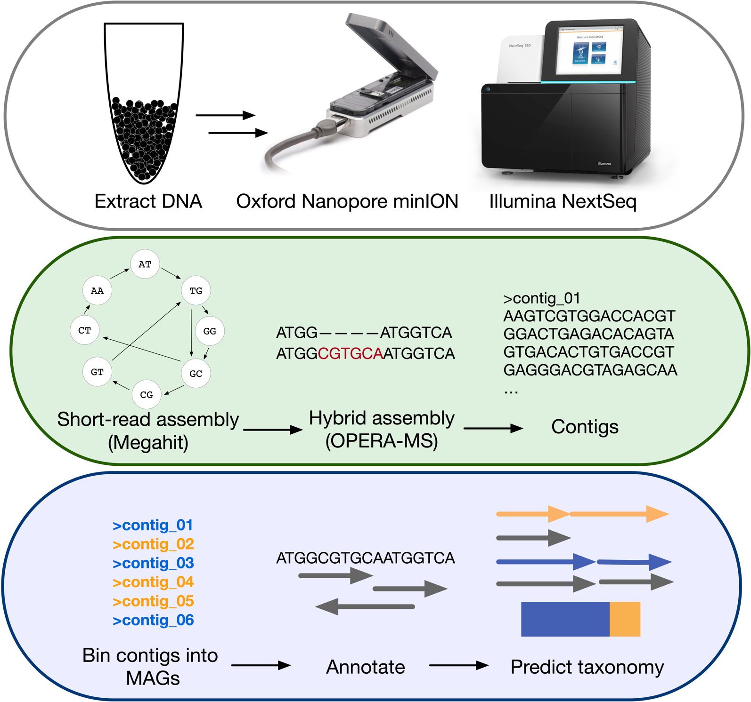
Metagenomically assembled genomes

Slide 19
Metagenomically assembled genomes

Slide 20
Metagenomically assembled genomes

Slide 21
Conclusions
Sequencing is not a swiss army knife
What people use is an accident of their training
You actually have to understand the technology from end-to-end
It’s all the same data
Sometimes it doesn’t matter
But when methods fail you won’t know
There are principled ways of dealing with sequencing data

Slide 22

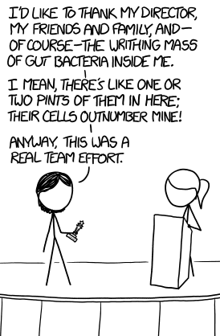


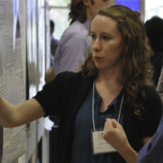




Andrew
Fernandes
Jean
Macklaim
Vera Pawlowsky-Glahn
Juan Jose Egozcue
Justin Silverman
philr
Tom Quinn
propr
Gregor Reid
Jeremy Burton
Daniel Giguere

